Slide 1

Towards Hierarchical Importance Attribution: Explaining Compositional Semantics for Neural Sequence Models
-Xisen Jinx, Junyi Dux, Zhongyu Weiy, Xiangyang Xuey, Xiang Ren
ICLR 2020
March 20, 2020
Presenter: Rishab Bamrara
https://qdata.github.io/deep2Read/

Slide 2
Motivation
Existing flat, word level explanations of predictions hardly unveil how neural networks handle compositional semantics to reach predictions.
Hence, we go for Hierarchical explanation systems like CD/ACD.
The key challenge => context independent importance of a phrase.
Notes:
The motivation of this project

Slide 3
Related Work
Interpretability of neural networks has been studied with various techniques:
Tenney et al. (2019): probing learned features with auxiliary tasks
Bahdanau et al., (2015): designing models with inherent interpretability.
Kadar et al., (2017): Input occlusion
Sundararajan et al., (2017): Additive feature attribution methods prediction
Murdoch et. al., (2018): CD
Singh et. al., (2019): ACD

Slide 4
Background
Additive feature attribution methods => explain a model prediction by assigning importance scores to individual input variables.
[Drawback: explaining compositional semantics]
CD/ACD => Go beyond the additive assumption and compute the contribution solely made by a word/phrase to the model prediction.

Slide 5
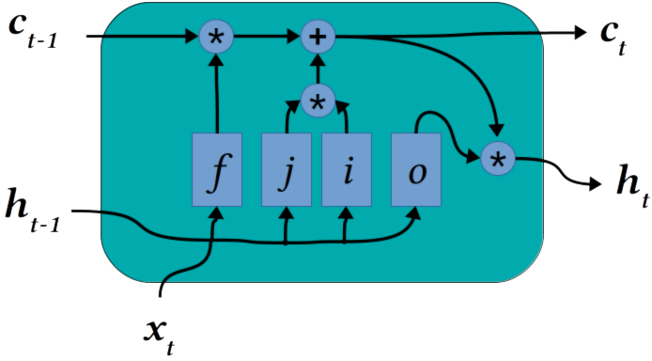
Background (Contd.)
β_{c}
γ_{c}
β_{t}
γ_{t}
https://blog.exxactcorp.com/5-types-lstm-recurrent-neural-network/

Slide 6
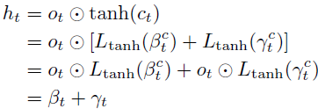

Background (Contd.)
CD computes the contribution solely from the phrase p as the average activation differences caused by assuming is present or absent as:

Slide 7
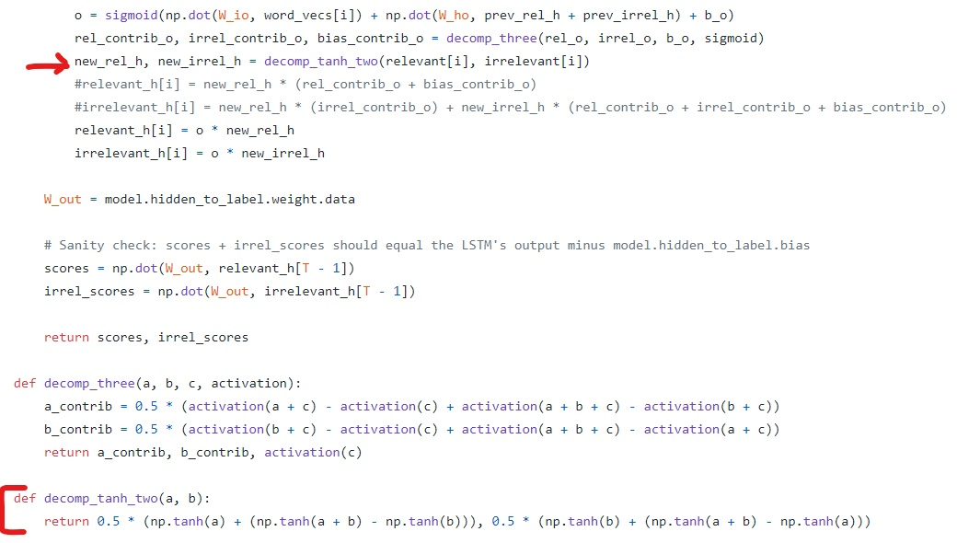
Background (Contd.)
https://github.com/jamie-murdoch/ContextualDecomposition

Slide 8

Background (Contd.)
CD evaluating interactions between two neighboring phrases:
where p1; p2 notes for concatenation of two phrases.
Similar in its form to marginal interactions in cooperative game theory, where each word corresponds to a player, and each phrase corresponds to a coalition of players.

Slide 9
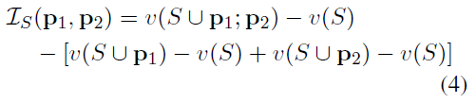
Background (Contd.)
Given a set of context words S, the marginal interaction between p1 and p2 is defined
as,
Eq. 3 can be interpreted as marginal interactions if Ø(p; x) could correspond to the term v(S ∪ p) - v(S) in Eq. 4.
However in CD/ACD, assigned importance scores depend on all other words in the sentence mathematically.

Slide 10
Claim / Target Task
Propose a mathematically sound way to quantify context independent importance of words and phrases for hierarchical explanations.
Based on the formulation, develop two effective hierarchical explanation algorithms, namely SCD and SOC.
Notes:
Here, we make the claim of this project.

Slide 11
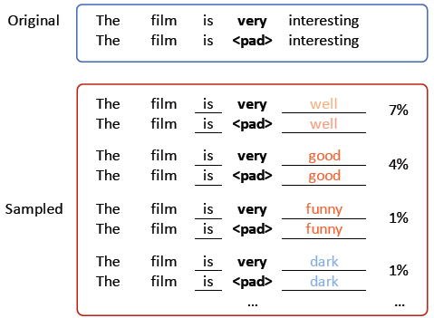
Proposed Solution
N-Context Independent Importance: Defined as the output difference after masking out the phrase p, marginalized over all the possible N-word contexts, denoted as x_{δ}^, around p in the input x.
Eg. The film is very interesting. (1-word context)
Notes:
Here is our proposed solution.

Slide 12
Proposed Solution (Contd.)
Context independent importance is formally written as:
x_{-δ} => resulting sequence after masking out an N-word context surrounding the phrase p from the input x.
x_{δ}^ => N-word sequence sampled from a distribution p(x_{δ}^/x_{-δ}).
s(x_{-δ};x_{δ}^) => model prediction score after replacing the original context words x_{-δ} with a sampled N-word context x_{δ}^.
x\p => the operation of masking out the phrase p from the input sentence x.
Notes:
Here is our proposed solution.

Slide 13

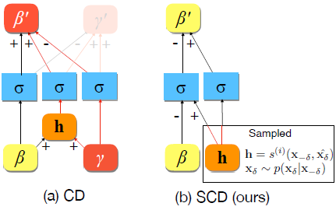
Proposed Solution (Contd.)
Sampling and Contextual Decomposition (SCD)
To eliminate the dependence, modified the activation decomposition step in CD:
By taking an expectation over γ, the dependence is eliminated. The masking operation x\p is implemented as calculating h-β.
Notes:
Here is our proposed solution.

Slide 14

Implementation
Algorithm:
Sampling a set of N-word contexts of the phrase p with a LSTM language model of both directions pretrained on the training set. (Gibbs sampling)
Replace the specific N-word context of the phrase p in the input x with sampled ones and feed each of them into the classifier model.
Record the inputs of each activation functions for each of input sequence.
The decomposition of the i-th nonlinear activation function is calculated as,
Notes:
Here is our proposed solution.

Slide 15
Proposed Solution (Contd.)
Sampling and Occlusion (SOC):
Input occlusion algorithms calculate the importance of p specific to an input example x by observing the prediction difference after replacing the phrase p with padding tokens, noted as O_{p}.
However, this importance score is also dependent on all the context words of p in x.
SOC calculates the average prediction difference after masking the phrase for each replacement of neighboring words in the input example.
Notes:
Here is our proposed solution.

Slide 16
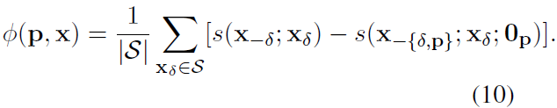
Implementation
Algorithm:
Sample N-word context of the given phrase p with the trained language model.
For each new sample, compute the model prediction differences after replacing the phrase p with padding tokens.
The importance Ø(p; x) is then calculated as the average prediction differences.
MODEL AGNOSTIC
Notes:
Here is our proposed solution.

Slide 17
Data Summary
Stanford Sentiment Treebank (SST): Standard NLP benchmark which consists of movie reviews ranging from 2 to 52 words long. In addition to labels of reviews, it also has labels for each phrase in the review.
Yelp Polarity: This was obtained from the Yelp Dataset Challenge. It has train and test sets of sizes 560,000 ad 38,000 respectively. Average length of review is 160.1 words. It contains only review labels.
TACRED relation extraction dataset: Contains 106,264 examples which cover 41 relation types.
Notes:
In the rest of this presentation, I’m going to talk about following contents:

Slide 18
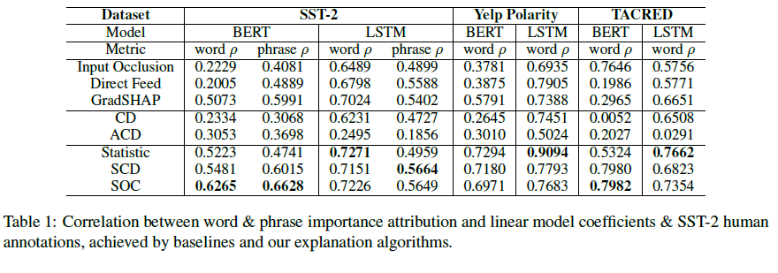
Experimental Results and Analysis
Hierarchical Visualization of Important Words and Phrases:
word ρ: Pearson correlation between the coefficients learned by a linear bag-of-words model and the importance scores attributed by explanation methods. (Used in CD)
Generally, explanation algorithms that follow proposed formulations achieve highest word and phrase ρ for all the datasets and models. The corpus statistic based approximation of the context independent importance yields competitive words, but it is not competitive for phrase.

Slide 19
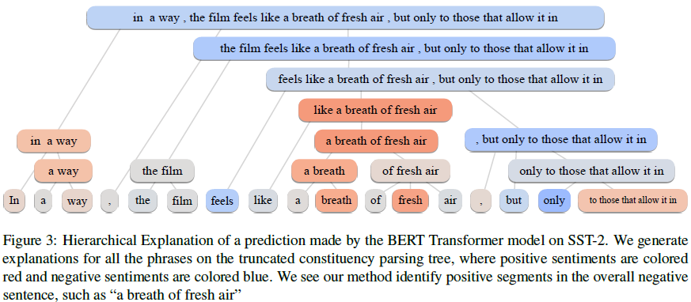
Experimental Results and Analysis

Slide 20
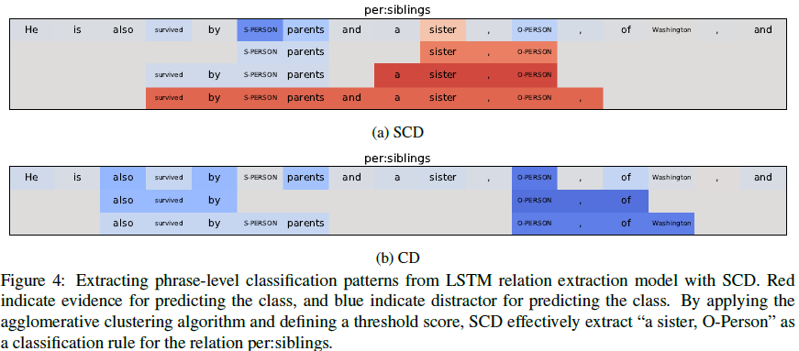
Experimental Results and Analysis(Contd.)
Explanation as Classification Pattern Extraction from Models:
Notes:
In the rest of this presentation, I’m going to talk about following contents:

Slide 21
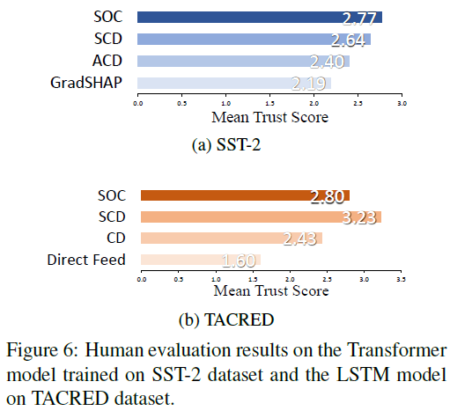
Experimental Results and Analysis(Contd.)
Enhancing Human Trust of Models: Asked subjects to rank the provided
visualizations based on how they would like to trust the model.
Notes:
In the rest of this presentation, I’m going to talk about following contents:

Slide 22
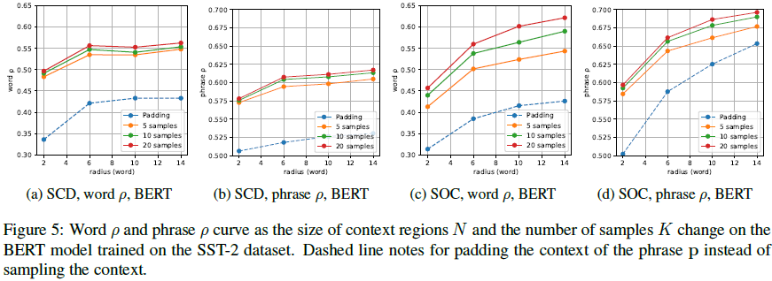
Experimental Results and Analysis(Contd.)
Parameter Analysis: Both SOC and SCD algorithms require specifying the size of the context region N and the number of samples K.
(1) sampling achieves better word and phrase ρ than padding
(2) the performance generally improves as the number of samples increase
(3) the performance improves as the size of the context region N increases at the early stage, and saturates when N grows large. It verifies words or phrases usually do not interact with the words that are far away them in the input.
Notes:
In the rest of this presentation, I’m going to talk about following contents:

Slide 23
Conclusion and Future Work
Authors identify context-independence as a desirable property for bottom-up hierarchical explanation, and propose a formulation to quantify context independent importance of words and phrases.
Experiments show that the proposed explanation algorithms generate reliable hierarchical explanations, and apply to explanation of compositional semantics, extraction of classification rules as well as improving human trust of models.

Slide 24
References
Dzmitry Bahdanau, Kyunghyun Cho, and Yoshua Bengio. Neural machine translation by jointly learning to align and translate. arXiv preprint arXiv:1409.0473, 2014.
W James Murdoch, Peter J Liu, and Bin Yu. 2018. Beyond word importance: Contextual decomposition to extract interactions from lstms. In ICLR.
W James Murdoch and Arthur Szlam. Automatic rule extraction from long short term memory networks. ICLR, 2017.
Jiwei Li, Will Monroe, and Dan Jurafsky. Understanding neural networks through representation erasure. CoRR, abs/1612.08220, 2016. URL http://arxiv.org/abs/1612.08220.
Mukund Sundararajan, Ankur Taly, and Qiqi Yan. Axiomatic attribution for deep networks. CoRR, abs/1703.01365, 2017. URL http://arxiv.org/abs/1703.01365.
Chandan Singh, W James Murdoch, and Bin Yu. 2019. Hierarchical interpretations for neural network predictions. In ICLR.
Lloyd S Shapley. 1997. A value for n-person games. Classics in game theory, page 69.

